Slide 1
Gender Differences in Tournament Choices: Risk Preferences, Overconfidence, or Competitiveness?
Roel van Veldhuizen
Lund University & WZB Berlin

Slide 2
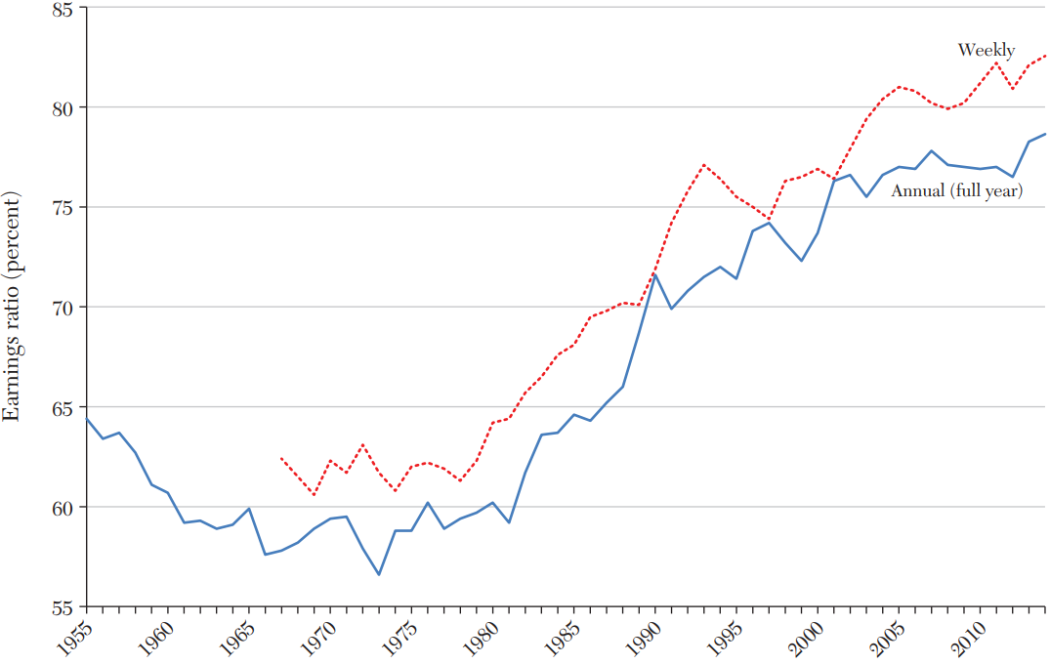
Gender differences in labor market
Gender Earnings Ratio
Source:
Blau, Francine D., and Lawrence M. Kahn. 2017. "The Gender Wage Gap: Extent, Trends, and Explanations." Journal of Economic Literature, 55 (3): 789-865.
Notes:
These are unadjusted data, based on full time workers. Adjusted gender ratio is about 91-92% since 1990.

Slide 3
Gender differences in competition
Sizable gender gap in labor market outcomes
  Lower wages, underrepresented in high level positions
Could be caused by...
  Discrimination, education, family reasons
Alternative: women less competitive than men
  Perform worse in competitive environments (Gneezy et al., 2003, QJE)
  Select out of competitive environments (Niederle & Vesterlund, 2007, QJE)

Slide 4
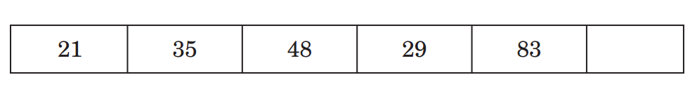
Niederle & Vesterlund, 2007
Participants had to add 5 2-digit numbers
Participants had to choose between:
  Piece rate, 50 cents per correct answer
  Tournament, 2 $ per correct answer if best performer within a group of 4, zero otherwise
Finding: women far less likely to choose tournament
  Despite similar scores on the task
Evidence that women less willing to compete
Notes:
Muriel Niederle, Lise Vesterlund, Do Women Shy Away From Competition? Do Men Compete Too Much?, The Quarterly Journal of Economics, Volume 122, Issue 3, August 2007, Pages 1067–1101, https://doi.org/10.1162/qjec.122.3.1067. The image of the five numbers comes from their paper.

Slide 5
Niederle & Vesterlund, 2007
Has been a very influential study
  >3500 Citations (google scholar)
  “Most influential experimental study” since 2000 (Gillen et al., 2019)
Main reason: discovery of a new personality trait called competitiveness
  Argued to explain results in lab experiments
  Could explain differences in the labor market
  New policy implications

Slide 6
Identifying Competitiveness
Other potential reasons for gender gap NV2007:
  Women may be more risk averse than men
    Tournament is riskier than piece rate
  Women may be less confident than men
Need to distinguish competitiveness from other explanations to claim that it matters.

Slide 7
Identifying Competitiveness
Risk Tolerant
+
+
Confident
+
+
Male
Entering Competition
+
Competitive
+
+
+
Other Factors?
Need to distinguish competitiveness from other explanations to claim that it matters.

Slide 8
Identifying Competitiveness
NV2007’s identification strategy:
  Participants choose tournament or piece rate
  Elicit proxies for risk preferences and confidence
  Use the elicited proxies as control variables in regressions

Slide 9
Identifying Competitiveness
Control for risk preferences and confidence
  Still a gender gap of 12.2pp (or 52.4% of the original gap)
Claim: 52.4% of original gap due to competitiveness
  “The large and significant residual in tournament entry after controlling for performances, confidence and risk aversion is labeled as gender differences in competitiveness.” (Niederle, 2017, AER: PP)
Source: Buser, Niederle, Oosterbeek (QJE, 2014)
Notes:
Buser et al. (2014) is more representative of the approach taken in the literature than Niederle Vesterlund (2007). It is Table 7 in their paper (column 1 vs 3)

Slide 10
Identifying Competitiveness
31 experiments with similar analysis:
Importance varies across studies
Competitiveness explains 72% on average!
Notes:
Figure 1 in the paper

Slide 11
Identifying Competitiveness
Summary:
  NV2007: women compete less than men
  Significant residual gap after adding controls
  Argument: residual gap must be driven by competitiveness
  Many replications: competitiveness 72%!
Implication: new psychological trait → impact on policy and research

Slide 12
Gillen, Snowberg, Yariv (2019)
NV2007 implicitly assume that their strategy filters out all confounding variables.
This requires all confounding variables to be measured perfectly
Clearly an unrealistic assumption…

Slide 13
Gillen, Snowberg, Yariv (2019)
To identify competitiveness, NV2007 implicitly assume they can measure risk preferences and confidence perfectly
Clearly an unrealistic assumption
  Measurement error likely sizeable.
Problem: creates a systematic bias…

Slide 14

A simulated example
Assumptions:
DGP well-behaved linear process:
$$Y=α+β_{1}R^{∗}+β_{2}B^{∗}+β_{3}R^{∗}B^{∗}$$
Men on average have Y=1, women Y=0
R* and B* are measured with IDD normal error:
$$R=γ_{1r}+γ_{2r}R^{∗}+η_{r}$$
$$B=γ_{1b}+γ_{2b}B^{∗}+η_{b}$$
Estimate following equation:
$$Y= \hat{α}+ {\hat{β}}_{1}R+{\hat{β}}_{2}B+{\hat{β}}_{3}RB$$

Slide 15
Gillen, Snowberg, Yariv (2019)
Measurement error biases the estimates
  Attenuates coefficients for noisy variables
  Inflates residual gender gap, which captures:
    Competitiveness (as NV2007 intended)
    Some of the effect of confounding variables

Slide 16
Identifying Competitiveness
Overestimated as a result
Downward biased because of measurement error
Notes:
Once again the Table is the one from Buser et al. (2014)

Slide 17
Gillen, Snowberg, Yariv (2019)
Measurement error biases the estimates
  Attenuates coefficients for noisy variables
  Inflates residual gender gap, which captures:
    Competitiveness (as NV2007 intended)
    Some of the effect of confounding variables
NV2007: residual gap is competitiveness effect
GSY2019: measurement error generates upward bias in residual, and hence competitiveness.

Slide 18
Gillen, Snowberg, Yariv (2019)
Correct regression estimate in following way:
  Obtain additional measures for control vars
  Use IV to filter out measurement error

Slide 19
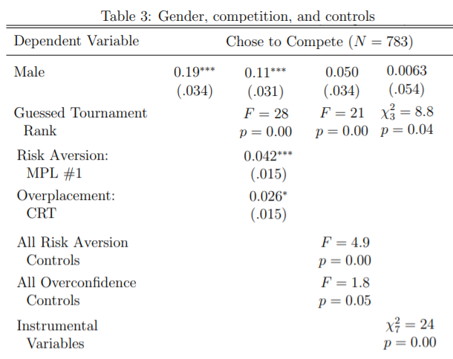
Gillen, Snowberg, Yariv (2019)
NV2007 approach:
Competitiveness: .11/.19=58%
GSY2019 more controls:
Competitiveness: .05/.19=26%
GSY2019 IV:
Competitiveness: .006/.19=3%
Source: their 2018 working paper version

Slide 20
Gillen, Snowberg, Yariv (2019)
Correct regression estimate in following way:
  Obtain additional measures for control vars
  Use IV to filter out measurement error
Finding: no role for competitiveness (!)
  NV2007 really just measure well-known gender differences in risk attitudes and confidence
  Major implications for research and policy

Slide 21
The competitiveness debate
NV2007: existence of competitiveness trait
GSY2019: fundamental flaw in existence proof
  Corrected proof: no effect of competitiveness
Current state of the debate:
  GSY2019’s general argument persuasive (JPE)
  But their solution no panacea (good instruments needed, linearity, classical measurement error)
  One data set (online, Caltech) vs many
  Potential issue relating to overcontrolling
Notes:
Overcontrolling: if some x-variable (e.g., risk preferences) is positively correlated with competitiveness, then this x-variable becomes a bad control that filters out part of the effect of competitiveness. This would generate a bias towards underestimating the importance of competitiveness. This bias runs counter to the measurement error bias GSY2019 identifies (which leads to overestimating competitiveness).

Slide 22
My contribution
Develop new strategy to identify competiveness
  Causal treatment based identification
  Different (fewer) assumptions
Add to the competitiveness debate
  Circumvent measurement error problem
  Cleaner identification (and more data!)
  Important for research and policy

Slide 23
Timeline
2014: run initial laboratory experiment
2016: first version of paper done
2019: experiment 2 for revision
These slides: focus mostly on original experiment
Notes:
The main reason for focusing on experiment 1 is that I presented this paper many times before experiment 2, and only a few times after. So the slides were made with experiment 1 in mind.

Slide 24
Overview
Identification Strategy
Experimental Design
Results of Experiment 1
Results of Experiment 2
Robustness checks
Additional Evidence
Implications

Slide 25
Identification Strategy

Slide 26
Niederle and Vesterlund (2007)
Participants had to add 5 2-digit numbers
Piece rate: 50 cents per correct answer
Tournament: 2 EUR per correct answer if best performer within a group of 4, zero otherwise
Notes:
Brief refresher on NV2007

Slide 27


Identification Strategy: Example
Baseline Treatment
T
T
T
PR
T
PR
PR
PR
Baseline result: men 50pp more likely to compete.
Notes:
Example of what might happen in NV2007. The photos are stock photos in the public domain.

Slide 28
Identification Strategy: Example
Baseline Treatment
I compete because I am competitive!
I do not compete because I dislike competitions!
T
T
T
PR
T
PR
PR
PR
Baseline result: men 50pp more likely to compete.

Slide 29
Identification Strategy: Example
Treatment that eliminates competiveness
T
T
T
PR
T
PR
PR
PR
Notes:
My approach: add a new treatment that eliminates the role of competitiveness.

Slide 30
Identification Strategy: Example
Treatment that eliminates competiveness
I used to compete because I am competitive…
T
T
T
PR
T
PR
PR
PR

Slide 31
Identification Strategy: Example
Treatment that eliminates competiveness
But now that competitiveness plays no role, I will choose piece rate instead….
T
T
T
PR
T
PR
PR
PR
PR

Slide 32
Identification Strategy: Example
Treatment that eliminates competiveness
I used to choose piece rate because I dislike competitions
T
T
PR
PR
T
PR
PR
PR

Slide 33
Identification Strategy: Example
Treatment that eliminates competiveness
But now that tournament no longer feels like a competition, I will choose it instead!
T
T
PR
PR
T
PR
PR
PR
T

Slide 34
Identification Strategy: Example
Treatment that eliminates competiveness
T
T
PR
PR
T
T
PR
PR
Control treatment: men and women equally like to compete
Notes:
In this example, competitiveness explains all of the gender gap in tournament entry. So removing its effect using a treatment should lead to a gender gap of zero.

Slide 35
Identification Strategy
Design a control treatment that:
  Removes the variable of interest (competitiveness)
  While keeping everything else constant
Compare gender gap across treatments
  If smaller in control, evidence for competitiveness
Causal mediation analysis using treatments

Slide 36

Experimental Design
Replicate tournament entry choice:
  Risk preferences (curvature of $u$)
  Overconfidence ($psubj>pobj$)
  Competitiveness ($u=u(x,T)$)
Then people make a second choice between:
  Eliminates role of competitiveness
Remove overconfidence by setting $p =pobj$
_{K}
Piece Rate | Tournament
0.5x for sure | 2x with probability p_{subj}

Slide 37

Experimental Design
Replicate tournament entry choice:
  Risk preferences (curvature of $u$)
  Confidence ($p_{subj}$)
  Competitiveness ($u=u(…,T)$)
Then people make a second choice between:
  Eliminates role of competitiveness
Remove overconfidence by setting $p =pobj$
_{K}
Piece Rate | Tournament
0.5x for sure | 2x with probability p_{subj}

Slide 38
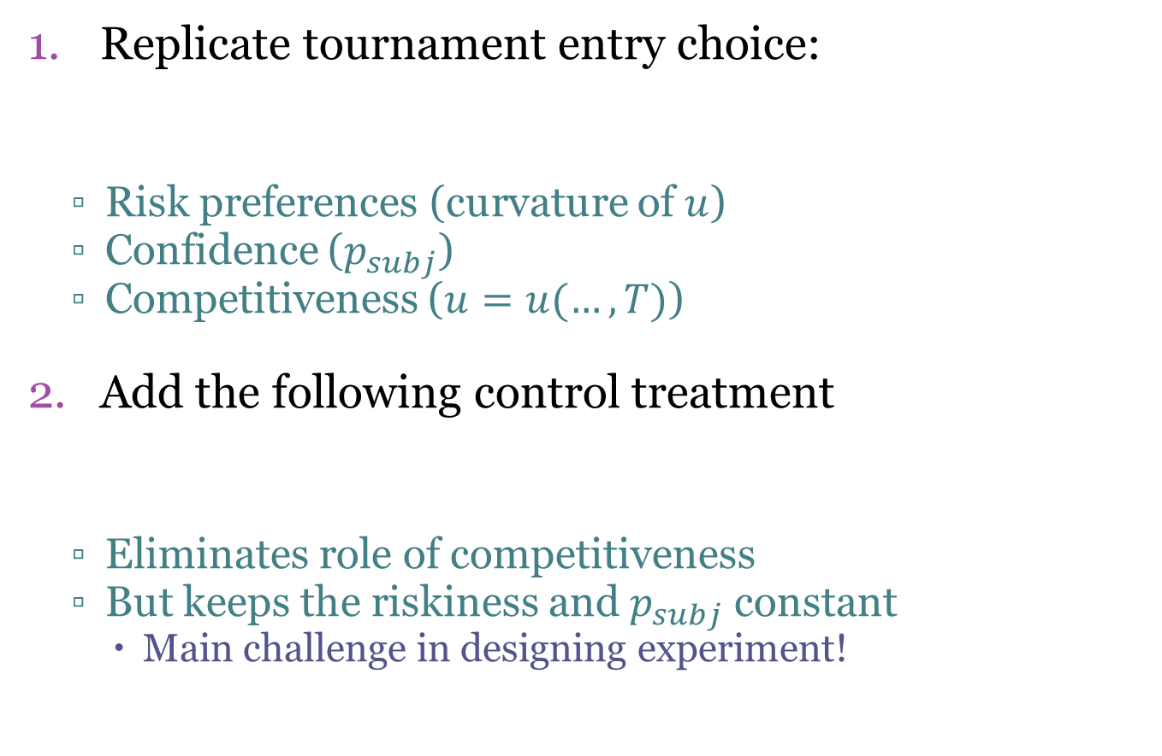
Experimental Design
Replicate tournament entry choice:
  Risk preferences (curvature of $u$)
  Confidence ($p_{subj}$)
  Competitiveness ($u=u(…,T)$)
Add the following control treatment
  Eliminates role of competitiveness
  But keeps the riskiness and $p_{subj}$ constant
    Main challenge in designing experiment!
_{K}
Piece Rate | Tournament
0.5x for sure | 2x with probability p_{subj}
Certain Outcome | Lottery
0.5x for sure | 2x with probability p_{subj}

Slide 39
Experimental Design
Tournament vs piece rate choice
Choice that eliminates role of competitiveness
Within-subject design
  Each participant makes both choices (same order)

Slide 40
1: Replicate Niederle & Vesterlund
Participants had to add 5 2-digit numbers
Stage 1: piece rate, 50 cents per correct answer
Stage 2: tournament, 2 euros per correct answer if best performer in group of 4
Stage 3: choose between piece rate and tournament
Notes:
This part is a standard replication of NV2007 that has been conducted many times.

Slide 41
Experimental design
Tournament vs piece rate choice
Choice that eliminates role of competitiveness
Within-subject design
  Each participant makes both choices (same order)

Slide 42
2: Eliminating competitiveness
Goal is to elicit the following:
Three Steps:
Obtain x (ability): performance in the task
Obtain p_{subj}: belief elicitation task
Elicit choice
Certain Outcome | Lottery
0.5x for sure | 2x with probability p_{subj}
Notes:
I don’t directly implement this treatment. Instead I obtain the choice in a somewhat roundabout way (with the three steps on the slides).

Slide 43
2: Eliciting choice
Choice A | Choice B
0.5x Euro | 2x Euro with p=1
0.5x Euro | 2x Euro with p=0.95
0.5x Euro | 2x Euro with p=0.90
... | ...
0.5x Euro | 2x Euro with p=0.05
For analysis, I only use the row with p=p_{subj}
Nevertheless, having multiple rows helpful:
  Experimental reasons
  Richer data
Notes:
Note that x is subject-specific. A person with a greater performance would face greater payments than one with a lower performance (x=performance in Stage 2 (see slide 40).

Slide 44
Identification Strategy Summary
For each participant, I compare two choices:
Competitiveness prediction:
  Gender gap in 1
  Smaller gender gap in 2 relative to 1
 | Choice |  | Type | Mechanisms
1 | 0.5x | 2x with prob p_{subj} | PR vs Tournament | Risk, Conf, Comp
2 | 0.5x | 2x with prob p_{subj} | Certain vs Lottery | Risk, Conf

Slide 45
Additional considerations
140 participants (70 men, 70 women)
Run in Berlin
End of experiment:
  One stage randomly chosen for payment
  Feedback only on this stage
  Followed by questionnaire (gender, risk prefs)

Slide 46
Preliminaries: performance
No gender differences in performance
Replicates Niederle/Vesterlund (and others)

Slide 47
Preliminaries: confidence
Men are more (over)confident (p=.007, t-test)
Replicates Niederle/Vesterlund (and others)
Notes:
The test is for confidence (the subjective win probability elicited in the experiment). But both genders are also overconfident, with the average elicited win probability being significantly greater than the true average objective win probability.

Slide 48
Preliminaries: risk preferences
Men are more risk-taking (p<.001, t-test)
Notes:
Qualitative measure (0-10 question “how willing to take risk in general”)

Slide 49
Main results

Slide 50
Main results
Men are more likely to compete (p<.0001)
Replicates Niederle/Vesterlund (and others)

Slide 51
Main results
Choice no longer competitive, yet ≈same results
Suggests competitiveness unimportant (!)

Slide 52
Treatment Estimate
Gender gap in T1 (tournament entry): 31.8pp
Gender gap in T2 (control treatment): 33.3pp
Competitiveness estimate: -1.5pp (-5%)
  Not significantly different from zero (p=0.56)
  Significantly different from regression (p=0.020)

Slide 53
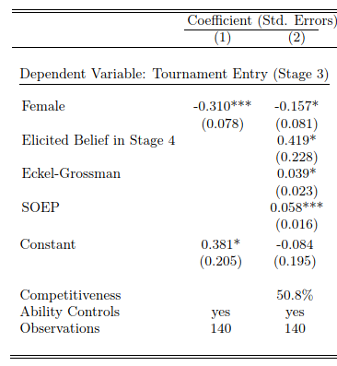
Regression Estimate
Overestimated as a result
Downward biased because of measurement error
Notes:
This is an abridged version of Table II in the paper.

Slide 54
Treatment Estimate
Gender gap in T1 (tournament entry): 31.8pp
Gender gap in T2 (control treatment): 33.3pp
Competitiveness estimate: -1.5pp (-5%)
  Not significantly different from zero (p=0.56)
  Significantly different from regression (p=0.020)
Robust to (not) removing outliers
Consistent with GSY2019
Notes:
Consistent with GSY2019, since the residualized estimate of competitiveness from the regression table appears to overstate the importance of competitiveness.

Slide 55
Experiment 1: Takeaways
Main result: removing the competitive element does not reduce the gender gap.
Implication: competitiveness does not explain the gender gap in tournament entry.
  Instead, driven by risk preferences and confidence
Contribution: identifying competitiveness using a causal treatment comparison

Slide 56
Experiment 2

Slide 57
Experiment 2
Inspired by reviewer feedback
  Sample size on the small side
  Order of tasks should be varied
  Add additional tests (more on them soon)
Same lab, 424 participants

Slide 58
Main results of experiment 2
Men are more likely to compete (p<.0001)
Similar to experiment 1, but a bit smaller (n.s.)

Slide 59
Main results of experiment 2
Removing role of competitiveness again no effect
Replication of my original result

Slide 60
Robustness Checks
Order effects & statistical power?
  Addressed by replication of main result in exp 2
Measurement error?
  How do mistakes in belief elicitation task and choices affect my results?
Elicitation method?
  Price list vs binary entry choice
  “Social risk” vs “nature risk”
Non-expected utility?

Slide 61
Measurement Error
The non-competitive choice is:
I elicited this choice in three steps
Obtain x (ability): performance in the task
Obtain p_{subj}: belief elicitation task
Elicit choice using price list
Main issue: p_{subj} likely to be measured with error
Certain Outcome | Lottery
0.5x for sure | 2x with probability p_{subj}

Slide 62
Measurement Error
Main issue: beliefs measured with error
  Used to “construct” the non-competitive treatment → effect on estimates?
My response:
Theoretical (y variable vs x variable)
Simulations (making beliefs noisier)
Additional treatment comparison

Slide 63
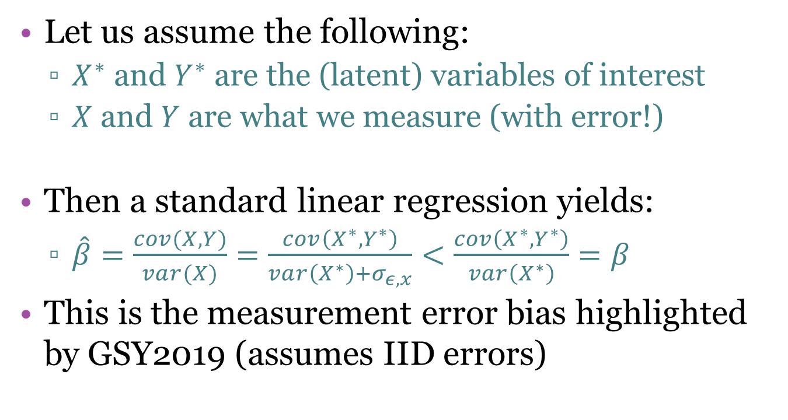
Measurement Error: Theory
Let us assume the following:
  $X^{∗}$ and $Y^{∗}$ are the (latent) variables of interest
  $X$ and $Y$ are what we measure (with error!)
Then a standard linear regression yields:
  $\hat{β}=\frac{cov(X,Y)}{var(X)}=\frac{cov\left(X^{∗},Y^{∗}\right)}{var\left(X^{∗}\right)+σ_{ε,x}}<\frac{cov\left(X^{∗},Y^{∗}\right)}{var\left(X^{∗}\right)}=β$
This is the measurement error bias highlighted by GSY2019 (assumes IID errors)

Slide 64
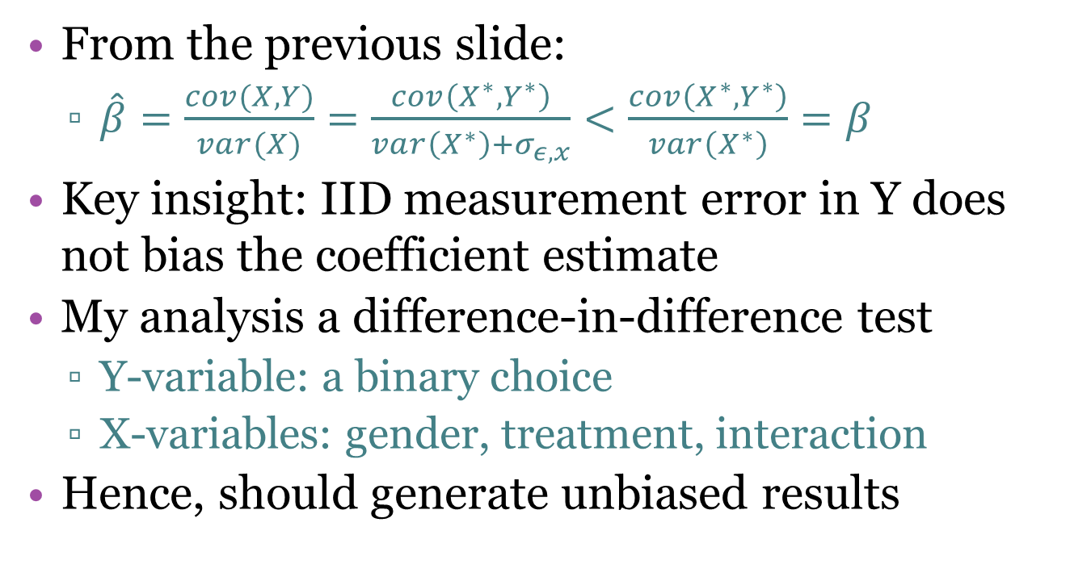
Measurement Error: Theory
From the previous slide:
  $\hat{β}=\frac{cov(X,Y)}{var(X)}=\frac{cov\left(X^{∗},Y^{∗}\right)}{var\left(X^{∗}\right)+σ_{ε,x}}<\frac{cov\left(X^{∗},Y^{∗}\right)}{var\left(X^{∗}\right)}=β$
Key insight: IID measurement error in Y does not bias the coefficient estimate
My analysis a difference-in-difference test
  Y-variable: a binary choice
  X-variables: gender, treatment, interaction
Hence, should generate unbiased results

Slide 65
Measurement Error: Treatments
New tournament entry choice:
  New: tell people how good they really are
  Changes the relevant probability to p_{obj}
Compare to the following control choice
  New: no longer requires beliefs to be measured
  Assumption: people believe me in step 1
  Steve blamer
Piece Rate | Tournament
0.5x for sure | 2x with probability p_{obj}
Certain Outcome | Lottery
0.5x for sure | 2x with probability p_{objj}

Slide 66
Measurement error: treatments
People less likely to “compete” overall (makes sense)
Same gender gap, no role for competitiveness
Replication using method without elicited beliefs

Slide 67
Elicitation Technique
T1: binary choice (compete or not?)
T2: price list elicitation
Could the different elicitation technique potentially explain my results?
Choice A | Choice B
0.5x Euro | 2x Euro with p=1
0.5x Euro | 2x Euro with p=0.95
0.5x Euro | 2x Euro with p=0.90
... | ...
0.5x Euro | 2x Euro with p=0.05

Slide 68
Elicitation Technique: Treatments
Treatment-based solution:
  Use a price list for both treatments
Part of another experiment (with V. Bartos)
  Procedures are complicated to explain
  Already planned before learning of revision
Result: no effect of competitiveness
  Point estimate: -29% (n.s.)

Slide 69
Additional evidence
Kessel et al. (2020)
  Similar design to experiment 1 (2-person tournament)
  Point estimate for competitiveness close to zero.
Two studies eliciting competitiveness directly
  Lozano and Reuben (2022)
  Bartos and Van Veldhuizen (2022)
  No gender gap in measure of competitiveness
Notes:
These two studies have an incentive compatiable measure that arguably measures competitiveness directly in a way that is unconfounded by other variables. Several other studies have attempted to measure competitiveness using a qualitative scale of some kind, but this scale may pick up risk attitudes, confidence and other factors in addition to competitiveness.

Slide 70
Additional evidence
Flory, Leibbrandt, List (2015)
  Field experiment, assistant jobs
  Same gender gap in applications with ‘competitive’ and ‘risky’ bonus payments
Other treatment comparisons
  Changing task, introducing quota all have major effect on behavior (e.g., Niederle et al., 2013)
  Not predicted by competitiveness
Notes:
For the second bullet point, the assumption I’m making is that quota do not affect competitive preferences directly. If they do (e.g., if adding a gender quota makes men less competitive), then the results from those studies are consistent with a competitiveness explanation as well.

Slide 71
Summary
Gender difference in willingness to compete
  NV2007: because of competitiveness trait
  GSY2019: not because of competitiveness
My contributions:
  Novel design with some advantages
  Several new experiments
  Also use data from other experiments
  Precisely estimated zero effect across several experiments

Slide 72
Implications
Policy:
  Making jobs less competitive may not be effective (Flory, Leibbrandt and List, 2015)
  Instead, reduce gender differences in beliefs (de-biasing) and risk preferences (?)
  Or reduce the role of beliefs and risk preferences
Research:
  Focus on gender differences in beliefs and RP
  Limited role of competitiveness potentially reassuring
Notes:
Why reassuring? Because we already have studied risk preferences and beliefs as a profession for many decades (they are key ingredients in EU, for example), whereas competitiveness is a more novel concept that has not yet been integrated into economic modelling.

Slide 73
Implications
Implications for experimentalists:
  Many experiments control for risk prefs, soc prefs, personality, etc., in regressions
  Potentially problematic
  Especially when key x-variable is non-random (e.g., gender, age, SES, culture, etc.)
Experimentalists can instead use additional treatments to circumvent this issue
Notes:
I propose to use treatments to circumvent the concerns raised by GSY2019. Basically: if something is important, don’t control for it in a regression. Instead try to design a treatment that removes its effect.

